Slide 1


Git & R - a love story
Integrate version control in your workflow now and your future self will thank you
…
ECOL5620 – Day 1
+

Slide 2
Git & R - a love story
Conceptual overview
Brief walk-through of how to get started
Matt-- more in- depth detail on structuring your workflow in RProjects

Slide 3

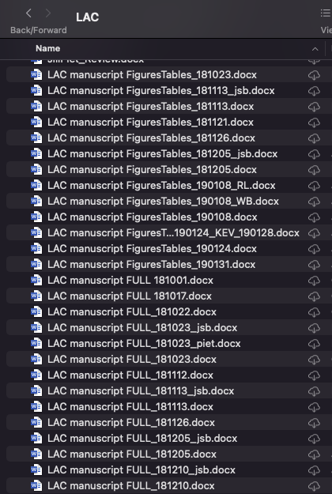

Version control – why we care
We’ve all been there, and we all probably have folders of dated files on our desktops, especially for written documents

Slide 4
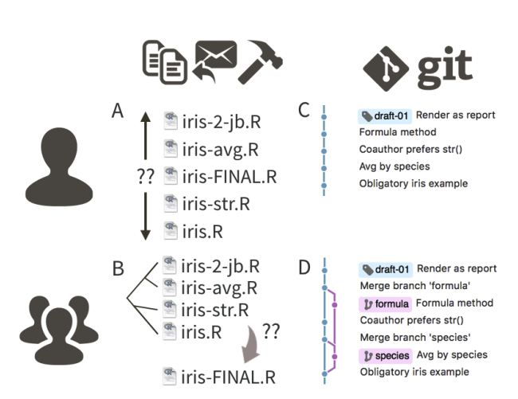
What is Git?
A version control system
Originally created for software developers; now widely used by data science community
A way of managing sets of files into a “repository” or ”repo”
Data, figures, reports, source code
Like “tracked changes” in MS Word, but more powerful!
Incredibly helpful for organizing projects and tracking history of changes and collaboration
J. Bryan 2018 The American Statistician
Notes:
Git is a version control system. Its original purpose was to help groups of developers work collaboratively on big software projects. Git manages the evolution of a set of files – called a repository or repo – in a sane, highly structured way. It is like the “Track Changes” feature from Microsoft Word, but more rigorous, powerful, and scaled up to multiple files.

Slide 5

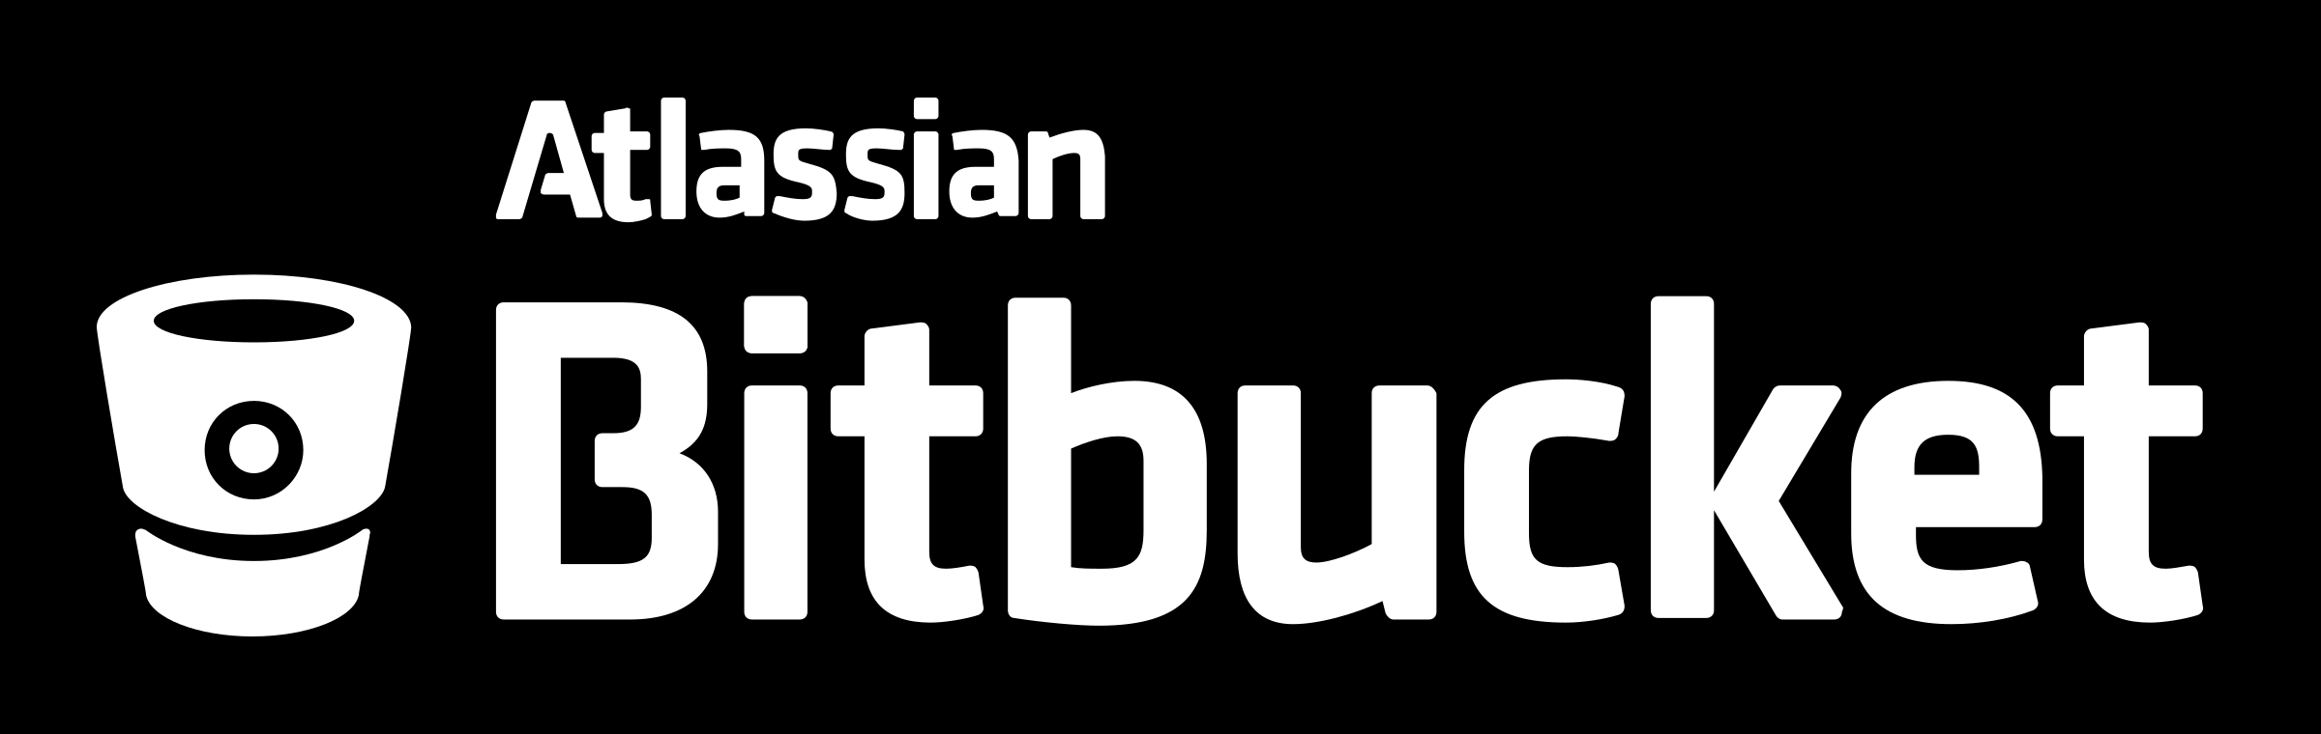

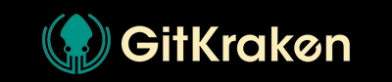
What is Git?
Git is the TOOL and GitHub is the HOST
Git | GitHub
Git is a software. | GitHub is a service.
Git is a command-line tool | GitHub is a graphical user interface
Git is installed locally on the system | GitHub is hosted on the web
Git is maintained by Linux. | GitHub is maintained by Microsoft.
Git is focused on version control and code sharing. | GitHub is focused on centralized source code hosting.
Git is a version control system to manage source code history. | GitHub is a hosting service for Git repositories.
Github isn’t the only player in the game:
Notes:
Git is a version control system. Its original purpose was to help groups of developers work collaboratively on big software projects. Git manages the evolution of a set of files – called a repository or repo – in a sane, highly structured way. It is like the “Track Changes” feature from Microsoft Word, but more rigorous, powerful, and scaled up to multiple files.

Slide 6


But I’m organized and work solo– why use Git?
Useful for working across multiple computers
Many journals are moving toward sharing code during peer review and/or publishing code
Open science
Forces you to organize in a way that is logical to others, not just you
Generate a web presence for yourself (great for jobs)
Eventually you won’t be working solo!
https://zenodo.org/record/5496240#.ZC9Up-zMI8Z
https://github.com/bellaoleksy/mohonkClimateTeleconnections
Notes:
Git is a version control system. Its original purpose was to help groups of developers work collaboratively on big software projects. Git manages the evolution of a set of files – called a repository or repo – in a sane, highly structured way. It is like the “Track Changes” feature from Microsoft Word, but more rigorous, powerful, and scaled up to multiple files.

Slide 7
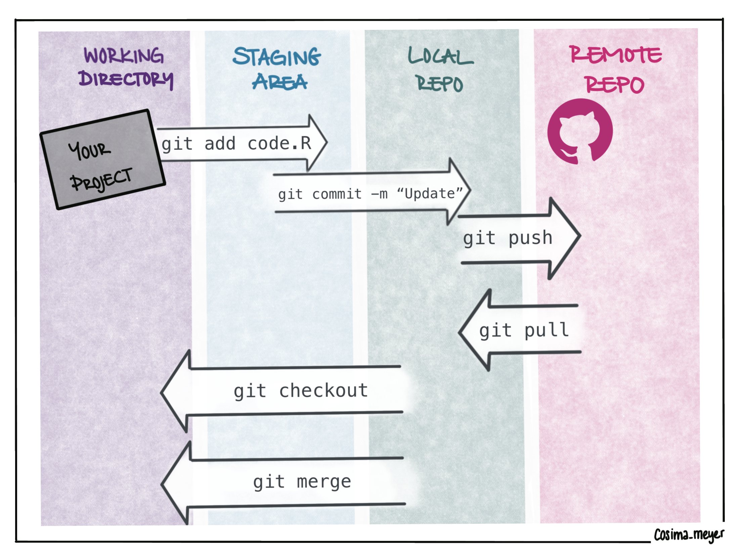
Git->Github basic workflow
Notes:
Git is a version control system. Its original purpose was to help groups of developers work collaboratively on big software projects. Git manages the evolution of a set of files – called a repository or repo – in a sane, highly structured way. It is like the “Track Changes” feature from Microsoft Word, but more rigorous, powerful, and scaled up to multiple files.

Slide 8
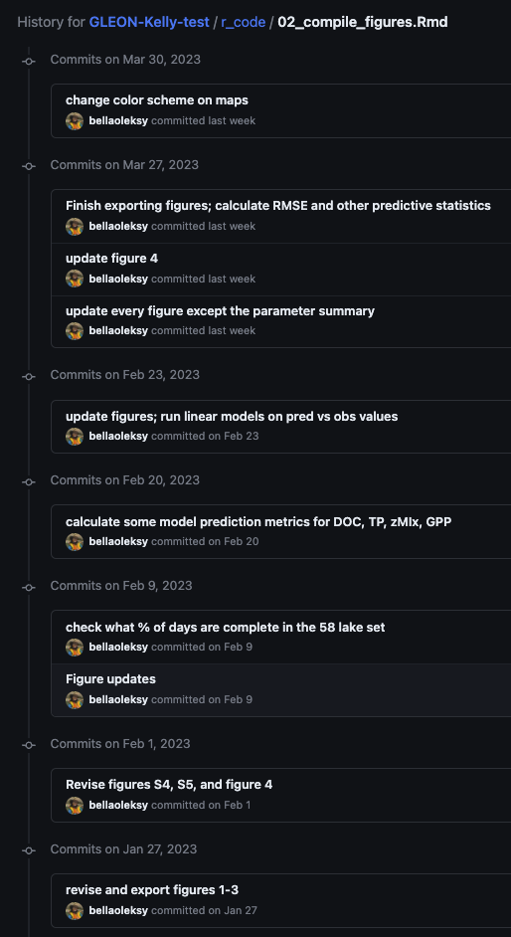
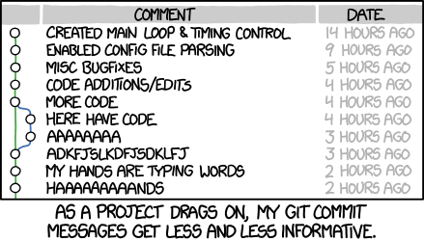
Git->Github basic workflow
“Commits” are cheap – make them useful and informative
From xkcd.com
Notes:
Git is a version control system. Its original purpose was to help groups of developers work collaboratively on big software projects. Git manages the evolution of a set of files – called a repository or repo – in a sane, highly structured way. It is like the “Track Changes” feature from Microsoft Word, but more rigorous, powerful, and scaled up to multiple files.

Slide 9
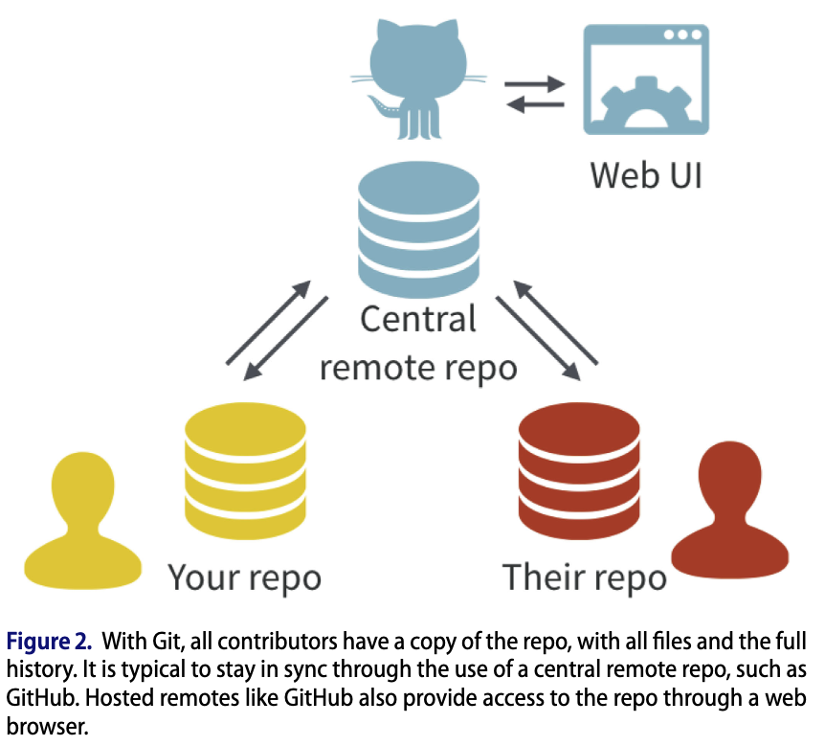
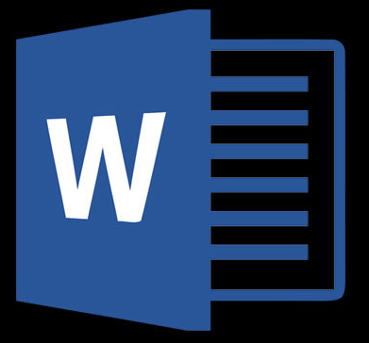
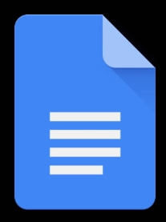
Git for collaboration
vs.
“Edit, initial, save, attach”
Annoying/difficult to reconcile multiple versions
Everyone has access to “master” version
Integrating edits is a built-in feature
Easy to revert to previous version if disaster strikes
J. Bryan 2018 The American Statistician
Notes:
Managing a project via Git/GitHub is much more like the Google Doc scenario, but also offers some of the attractive features of “edit, save, attach.” With Git/GitHub, collaborators can work offline and there can be independent lines of development, that is, branches. The killer feature is that Git/GitHub enables regular and structured reconciliation of all versions of all the files in the project. It is definitely more complicated than collaborating on a GoogleDoc, but also more powerful

Slide 10
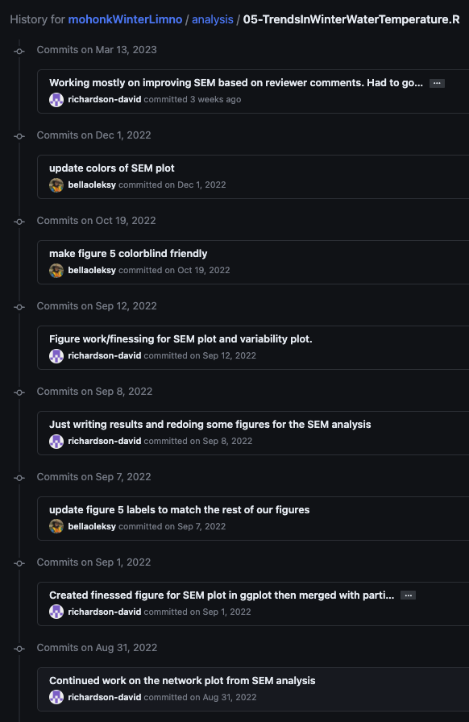
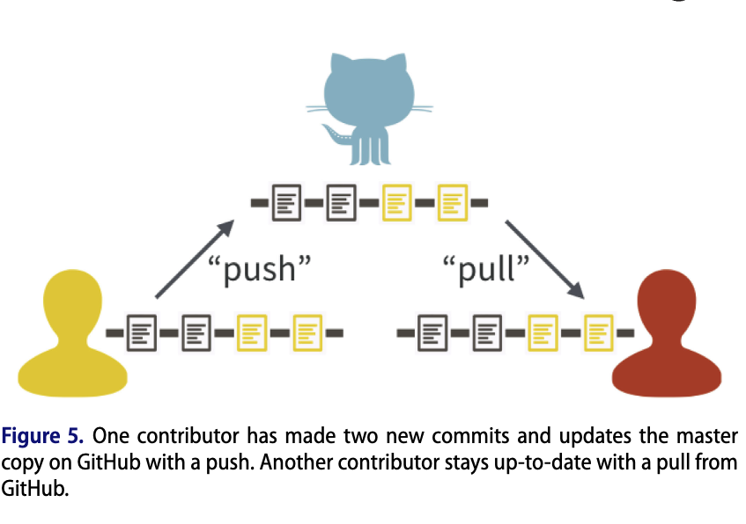
Git for collaboration
J. Bryan 2018 The American Statistician
Notes:
Git is a version control system. Its original purpose was to help groups of developers work collaboratively on big software projects. Git manages the evolution of a set of files – called a repository or repo – in a sane, highly structured way. It is like the “Track Changes” feature from Microsoft Word, but more rigorous, powerful, and scaled up to multiple files.

Slide 11
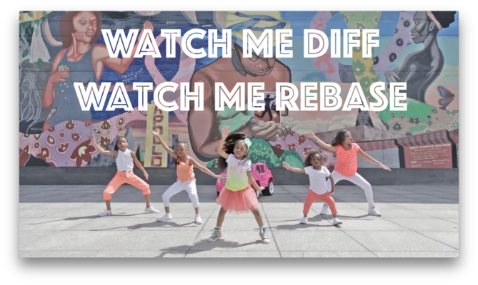
Git & R – the ultimate reference
https://happygitwithr.com/
Notes:
Git is a version control system. Its original purpose was to help groups of developers work collaboratively on big software projects. Git manages the evolution of a set of files – called a repository or repo – in a sane, highly structured way. It is like the “Track Changes” feature from Microsoft Word, but more rigorous, powerful, and scaled up to multiple files.

